Slide 1
InnoMITE
Where Technology meets Innovation

Slide 2
What is InnoMITE
A dynamic startup software house, we specialize in developing cutting-edge solutions in the realm of IoT, hardware, and software development.

Slide 3
WHY INNOMITE EXISTS
InnoMITE emerges from a vision to revolutionize businesses through advanced IoT, hardware, and software solutions. In today's tech-driven era, seamless integration of hardware and software is pivotal for optimizing operations and enhancing user experiences. InnoMITE is committed to filling this void by providing cutting-edge solutions tailored to the evolving needs of modern businesses.

Slide 4
HOW INNOMITE ACHIEVES ITS MISSION
At InnoMITE, innovation is at the core of everything we do. Our multidisciplinary team of experts collaborates seamlessly to develop bespoke products in POS, inventory management, attendance systems, and face recognition technology. Leveraging our proficiency in both hardware and software development, we engineer solutions that seamlessly integrate IoT capabilities, enabling businesses to achieve new levels of efficiency and productivity. By adopting agile methodologies

Slide 5
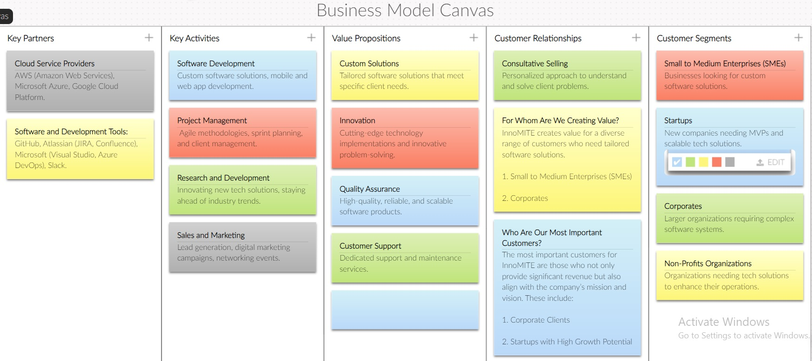
InnoMITE Business Model Canvas

Slide 6
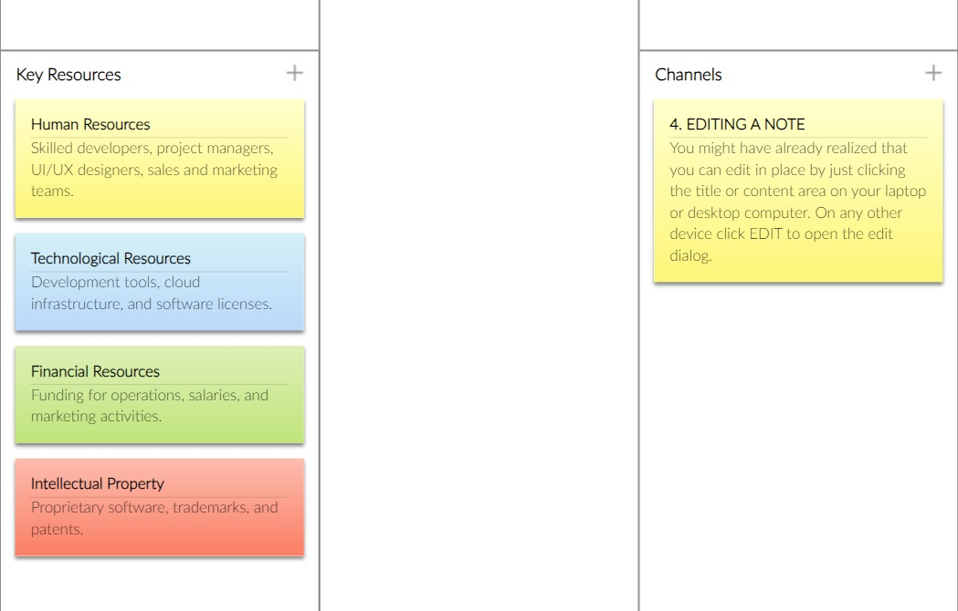
InnoMITE Business Model Canvas

Slide 7
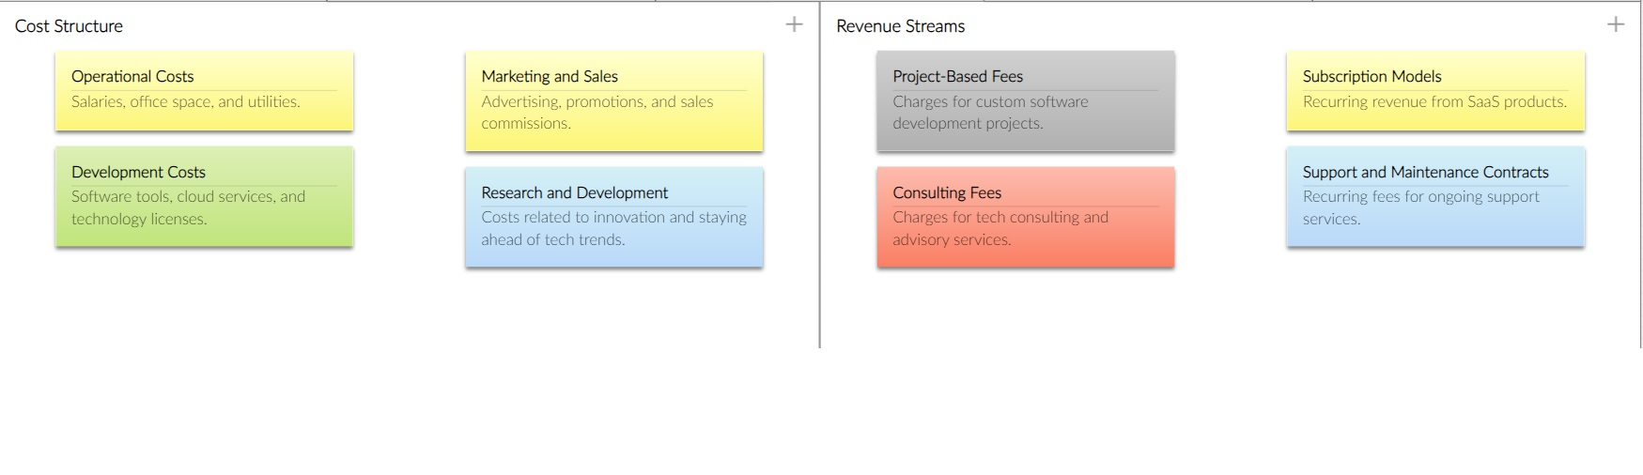
InnoMITE Business Model Canvas

Slide 8
Market Opportunity for InnoMITE
1. Growing Demand for Custom Software Solutions
----------------------------------------------------------------------------------------------------------------------
The demand for custom software development services is rapidly increasing as businesses across various industries recognize the need for tailored solutions to meet their unique requirements

Slide 9
Global Market Expansion
With advancements in technology, geographic barriers are diminishing, allowing InnoMITE to tap into global markets
Outsourcing and Offshoring: Providing software development services to companies in regions with high demand and limited local resources.

Slide 10
Conclusion
The opportunity for InnoMITE is substantial, driven by the increasing demand for custom software solutions, the growth of mobile and web applications, the thriving startup ecosystem, and the digital transformation initiatives of large corporations.

